Slide 1
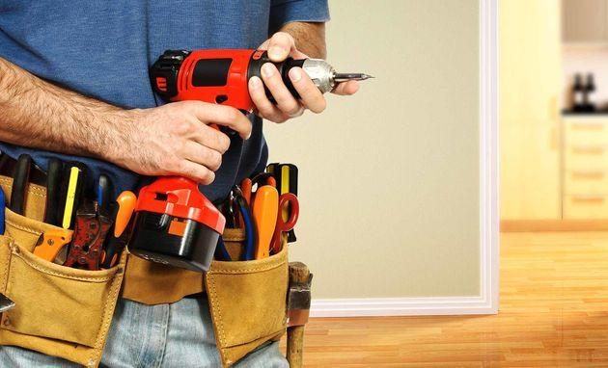
Handyman Reviews
Sentiment
Analysis

Slide 2
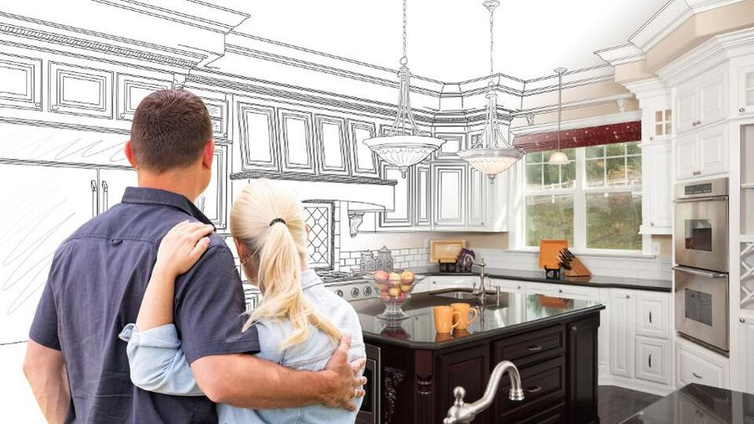
The home improvement market is estimated to be over $350 Billion.

Slide 3

What is a Handyman
A handyman is an individual who performs small home repairs as a business.

Slide 4

Project Goal:
Create a Sentiment Analysis Model to predict the sentiment of online reviews

Slide 5
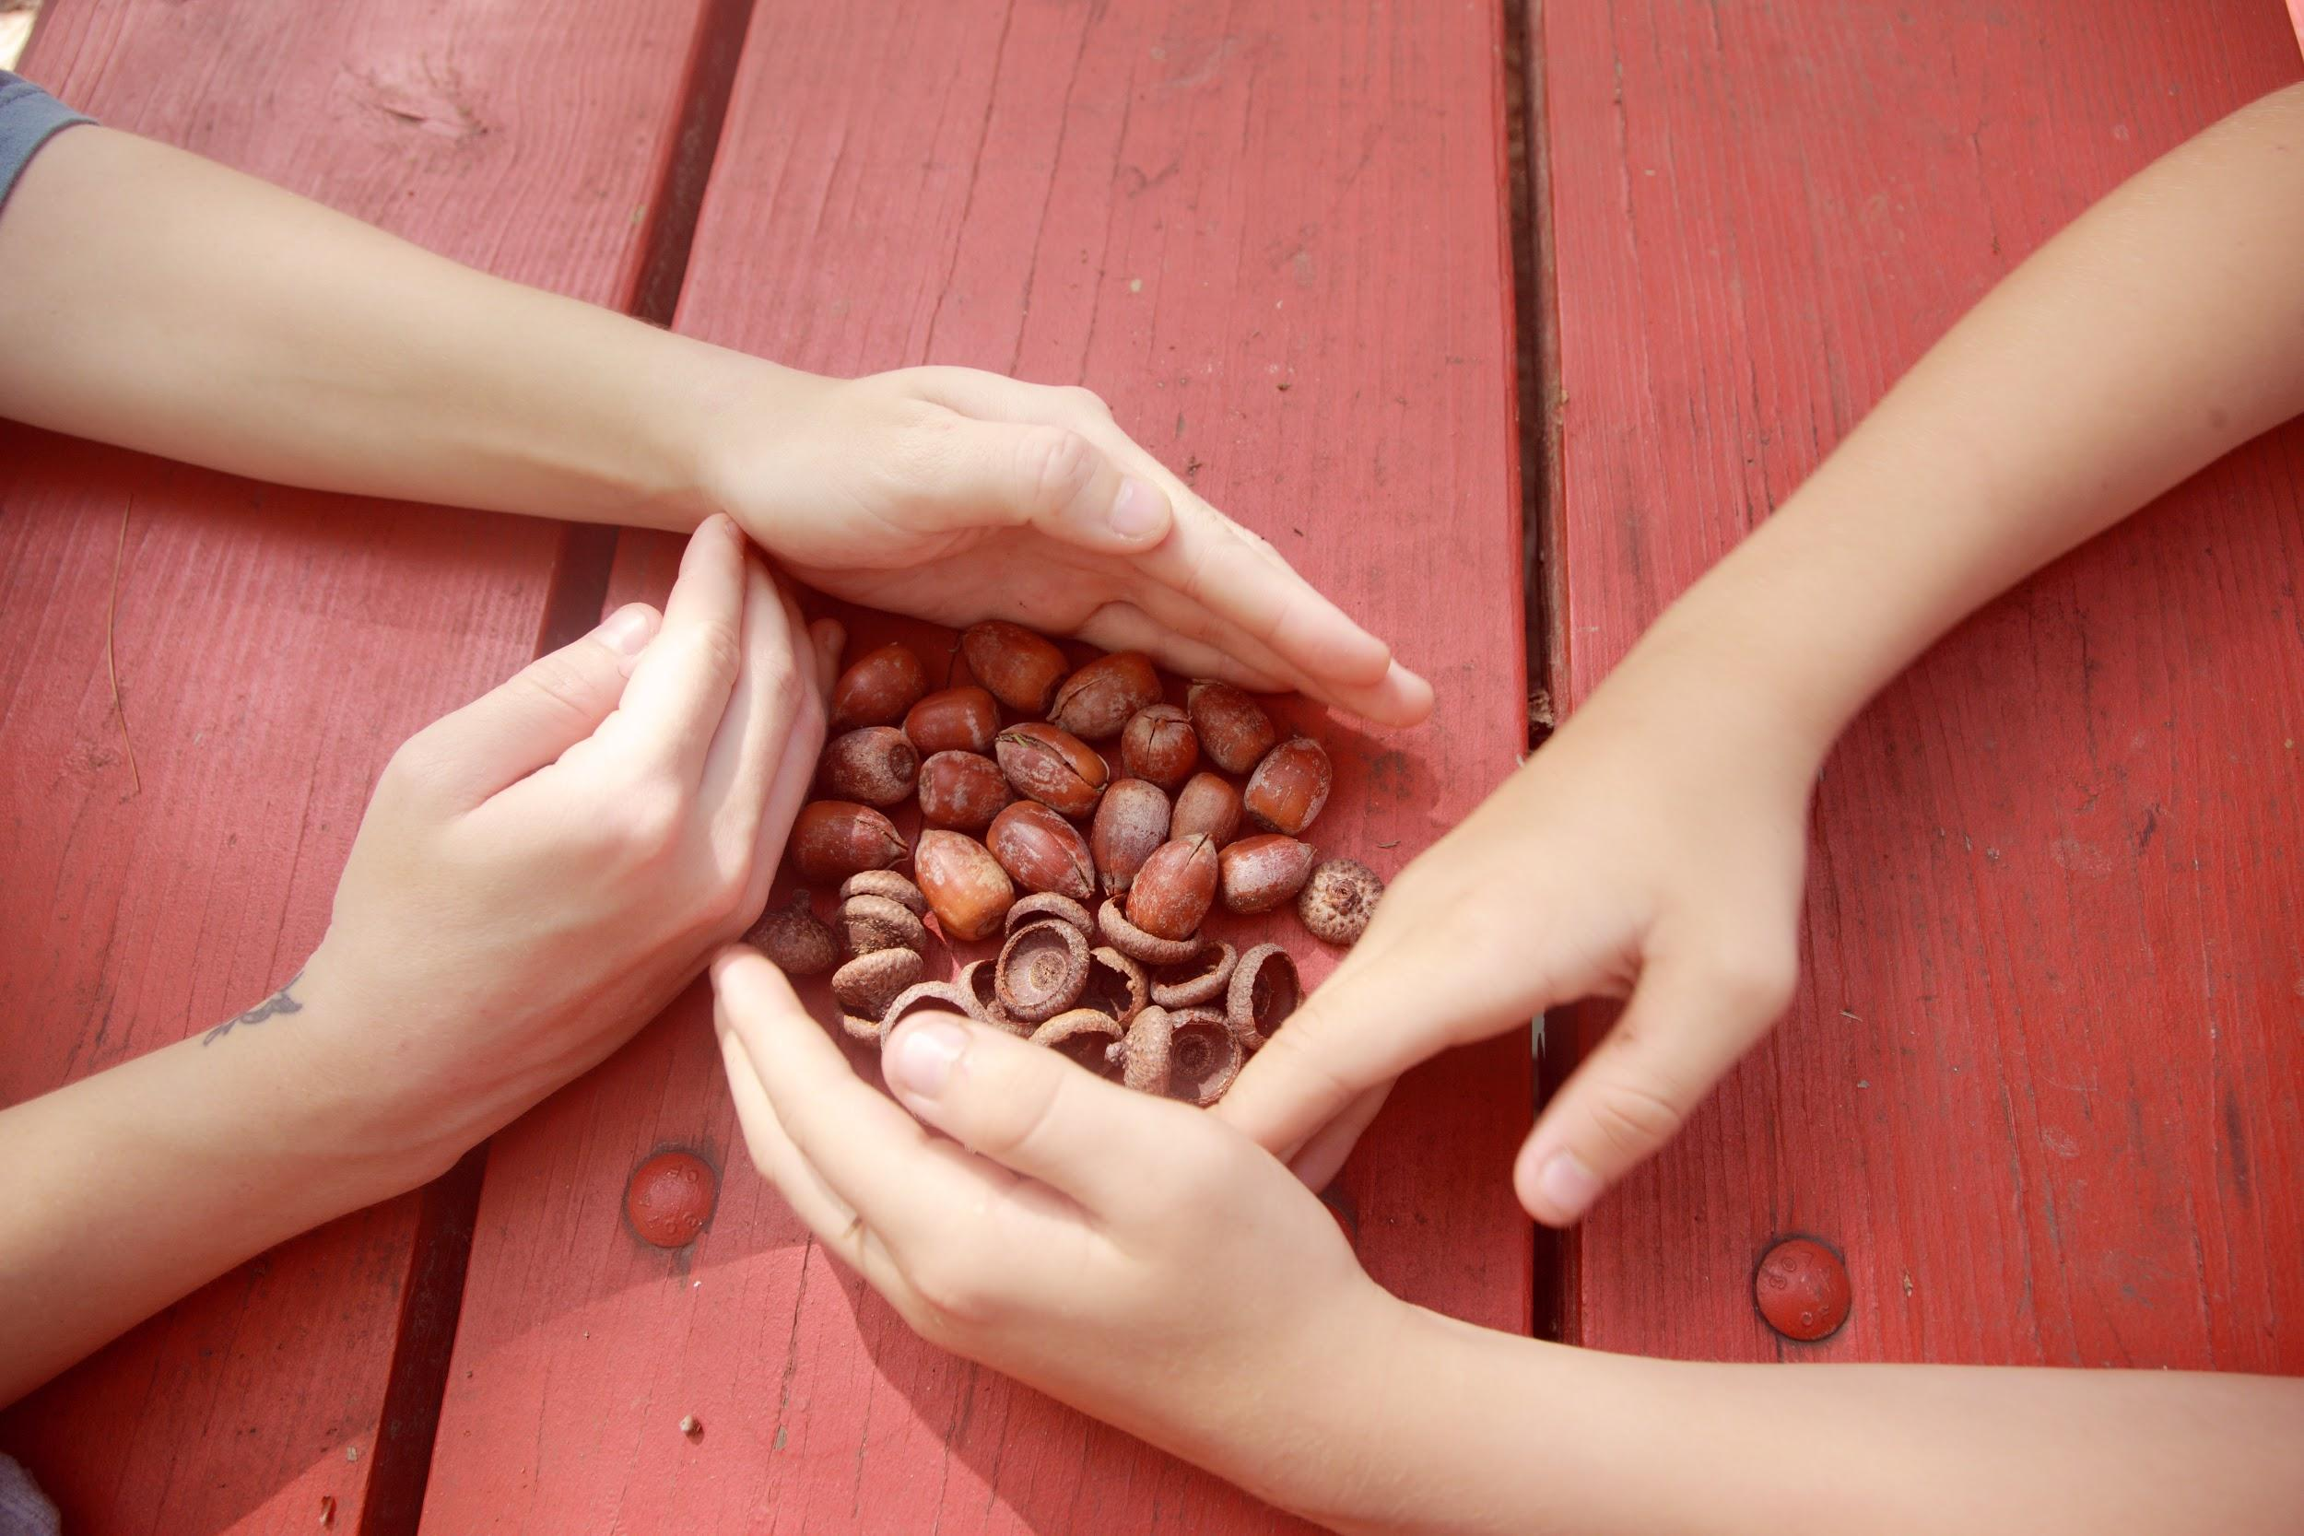
Gathering/Preparing Data

Slide 6

Yelp Open Dataset:
8 Million + Observations
8 columns

Slide 7

Data Manipulation
Reduced dataset from 8 million + rows to 7000 rows handyman specific observations.

Slide 8
Customer Review Split
LOW RATINGS
1 Star
2 Star
HIGH RATINGS
4 Star
5 Star

Slide 9

Exploratory Data Analysis

Slide 10

Exploration Techniques
N-Grams Analysis
Word Frequency analysis
NTLK Parts of Speech analysis

Slide 11
LOW RATINGS
Key N-grams
“Stay away from”
“Go somewhere else”
“Would not recommend”
High Frequency words
“Horrible”
“Wrong”
“Unprofessional”
Key Parts-of-Speech
“Worst”
“Disappointed”
“Expensive”

Slide 12
HIGH RATINGS
Key N-grams
“I highly recommend”
“Was very professional”
“Came out”
High Frequency words
“Friendly”
“Honest”
“Fixed”
Key Parts-of-Speech
“Great”
“Professional”
“Best”

Slide 13

Model Building

Slide 14

Model Building
Transform:
TFIDF_Transformer was applied to the reviews and labels.
Baseline Model:
Naive_Bayes Classifier
Metrics:
Accuracy, F1, Recall, Precision

Slide 15
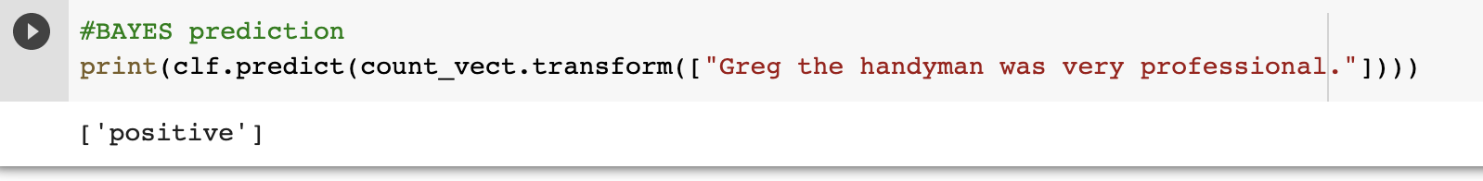
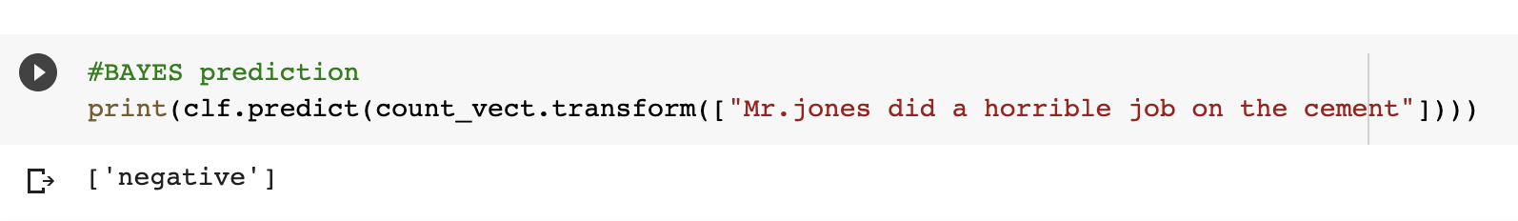
Baseline Model Predictions

Slide 16
.716
Baseline Model Accuracy

Slide 17

Oversampling
The positive review rows was 5500. The negative review rows were 1500. I reduced the positive review rows to 1700. To reduce the oversampling.

Slide 18
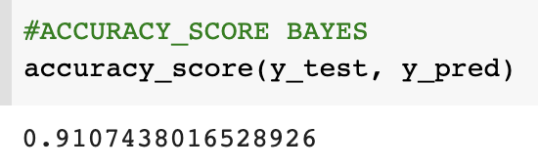
New Baseline Model Score

Slide 19
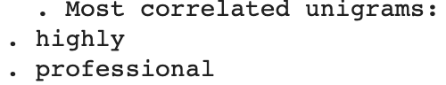
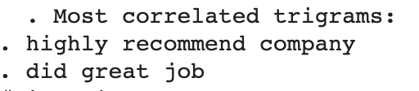
CHI Squared Results

Slide 20
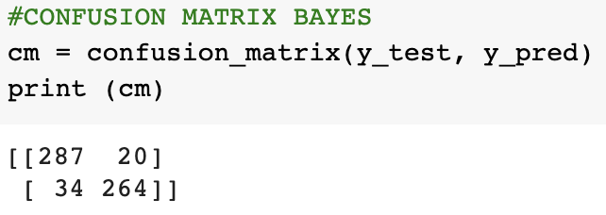
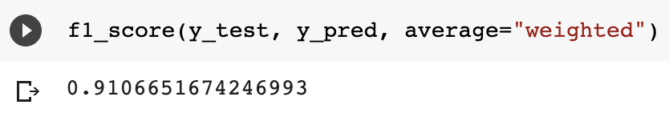
Baseline Model Metrics
F1 Score
Confusion Matrix

Slide 21
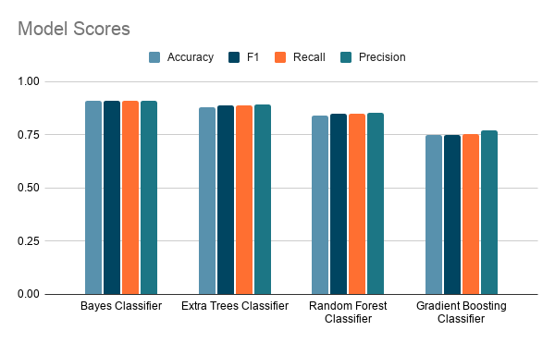

Slide 22
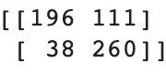
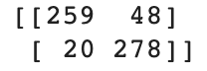
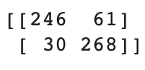
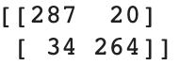
Confusion Matrices
Extra Trees
Gradient Boosting
Random Forest
Naive Bayes

Slide 23
Next Steps
Manipulate more parameters of the models to increase metrics

Slide 24
Questions?

